Slide 1
Inertial SENSOR fUSION
Steven Paustian
CS 489
Instructor: Dr. Jun Zheng
Spring ‘14

Slide 2
Inertial Measurement Units
Inertial Measure Units (IMUs) are the compilation of multiple sensors interpreted together to detect the movement of the device.
Combining the measurements obtained by the Accelerometer, Gyroscope, Magnetometer etc… to gain:
Velocity
Orientation
Gravitational Forces

Slide 3
Accelerometer Overview & Limitations
Does not measure true linear acceleration, but deviation from free-fall.
Noisy
High or Low Pass Filter.
Velocity & Drift
Acceleration = dv/dt
To obtain velocity, we must approximate an integral: V(t)≈∑ V(t)T_s
Drift: Minor errors in-between sampling accumulate over time!
Need to combine gyroscope, or a second accelerometer!

Slide 4
Gyroscope Overview & Limitations
Measures rotational acceleration.
Angle & Drift
Rotation Acceleration = dϴ/dt
To obtain current angle of rotation: ϴ(t) ≈ ∑ ϴ(t) T_s
Just like the accelerometer, drift occurs because small non-smooth changes in rotation between sampling rates adds up over time a.k.a Drift.
Must couple with accelerometer, magnetometer, or a second gyroscope.

Slide 5
Magnetometer Overview & Limitations
Commonly called a compass
Measure the strength of magnetic fields along three axes.
Magnetic component (theoretically) always points towards magnetic north.
Magnetic Fields vary and experience interference.
Our own knowledge of earth’s magnetic field is inconsistent.
Ferrous materials interfere with readings.
Outside objects interfere at distances up to 100ft.
Materials in the device itself interfere:
Battery
Circuit Board
Therefore magnetometer can only be used for motion detection under ideal circumstances i.e. Not Often.

Slide 6
GPS Overview & Limitations
Global Positioning System
GPS receivers computer speed as Kalman filtered distance vs. time & Doppler shift.
Requires line of sight with at least four satellites.
If unavailable, Android and Apple APIs default to cell tower localization.
Coordinates cannot be queried at a specific time
Coordinates are computed automatically, at regular intervals when available.
It is not possible to force a query.
Must compare current position with last known position.

Slide 7
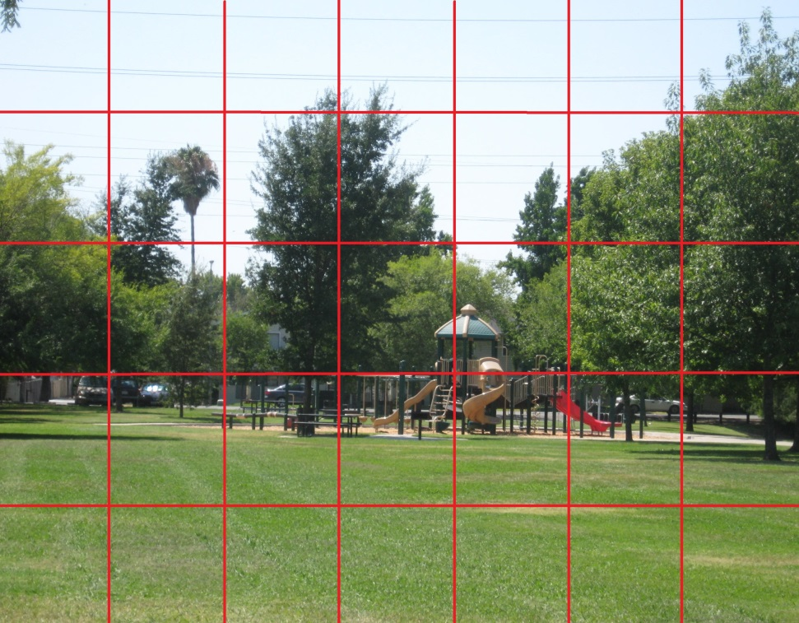
Camera Overview
Inertial measurements using a camera can be performed by plotting image signatures against a coordinate system.
Changes in the signatures relative to the coordinate system indicate inertial change.
Very resource intensive for mobile devices.
Can be used to augment accelerometer & gyroscope
Accuracy of positional estimation dependent upon image quality
Sampling rate (FPS) is usually much lower than other sensors

Slide 8
General Limitations
Sampling frequency is NOT constant
Frequent interruptions due to low priority.
The more sensors being polled, the higher the battery cost.
When high sampling of accelerometer, gyroscope, magnetometer there is a battery cost of ~7.15% per hour.
The more sensors, the more resource expensive
Especially the camera
How do we know which information to trust?

Slide 9
Sensor Fusion
Process of integrating sensor information from several different sources into one coherent reading.
It is necessary to intelligently interpret accelerometer, magnetometer, and gyroscope readings.
Vast majority of algorithms use some type of Kalman filter.

Slide 10
Kalman Filter
Recursive way to integrate multiple sources of information.
Using the different “perspectives” of different sensors, better understanding of what’s happening
“Fuses” the data from different sensors into a better estimate.
Generates optimal estimate of desired quantities given certain data.
Doesn’t need to store all previous measurements for reprocessing.
Multiple flavors of the filter: Extended, Discrete, Continuous, Unscented….

Slide 11
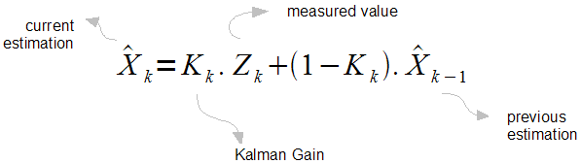
How does it work?
Fairly Heavy Math:
Matrices & Linear Algebra
Finds the most optimum averaging factor for each data source.
Provides “weights” for data sources to predict best “estimate.”

Slide 12
How does it work?
Step 1: Setup and Initial Estimates
Two distinct sets of equations: Prediction & Measurement
Create initial estimate of value using initial datums.
Step 2: Iterate
Gather sensor data for initial step and calculate weights. (Measurement)
Project the next state based on current data (Prediction)
Gather data for next time-step (Measurement)
Update measurement with comparison to last prediction.
Calculate Gain
Update Measurement
Calculate variance between initial measurement and update measurement
Repeat until variance approaches a constant (Get as close to the real value as we can)

Slide 13
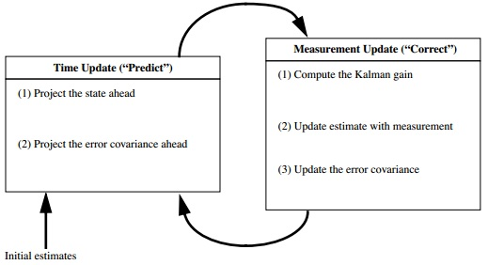
Kalman Filter contd…

Slide 14
Kalman Filter Limitations
Can be complex, especially when fusing more than 2 sensors.
Initial estimates of sensor data and Co-Variance need to be reasonable.
Standard Kalman filter requires Linear relationships between sensor data.
Other flavors of the filter do not require this.

Slide 15
Complimentary Filter
Steady state Kalman filter.
Much simpler to implement.
A favorite of robot & mobile app enthusiasts.
Widely used to combine accelerometer, gyroscope, and magnometer to retrieve velocity and angle of rotation.
Uses pre-computed weight averages to correct sensor data.

Slide 16
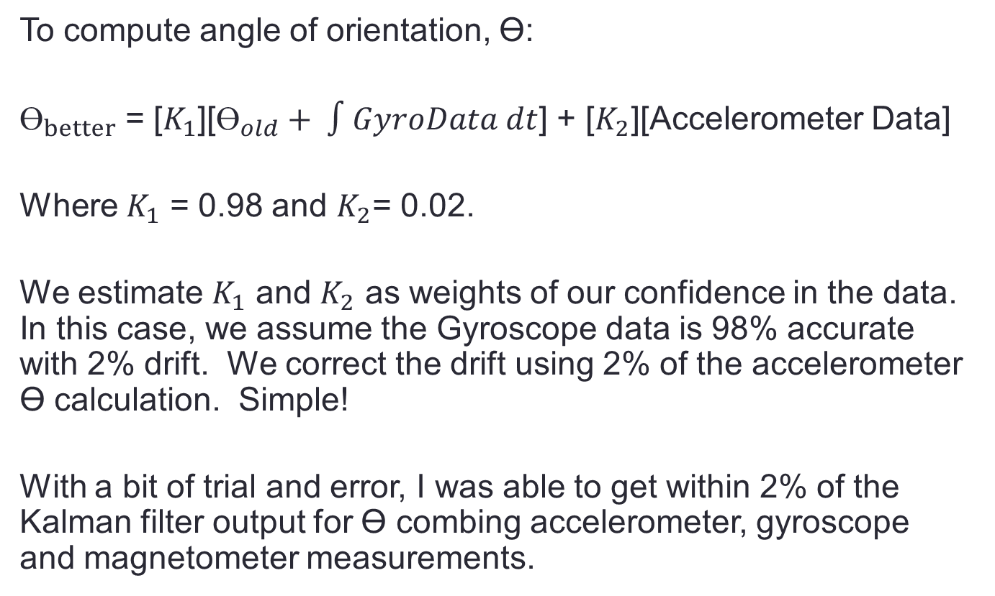
Complementary Filter Example
To compute angle of orientation, ϴ:
$ϴ_{better}$ = [$K_{1}$][$ϴ_{old}+ ∫GyroData dt$] + [$K_{2}$][Accelerometer Data]
Where $K_{1}$ = 0.98 and $K_{2}$= 0.02.
We estimate $K_{1}$ and $K_{2}$ as weights of our confidence in the data. In this case, we assume the Gyroscope data is 98% accurate with 2% drift. We correct the drift using 2% of the accelerometer ϴ calculation. Simple!
With a bit of trial and error, I was able to get within 2% of the Kalman filter output for ϴ combing accelerometer, gyroscope and magnetometer measurements.

Slide 17
Complimentary Filter Limitations
No automatic weight calculations like with the Kalman filter.
Not as accurate.
Accuracy decreases as the # of sensors fused increases.

Slide 18
Energy Concerns
The more sensors get fused, the higher the battery cost.
Can either:
Decrease Sampling rates
And therefore decrease accuracy of inertial measurements
Turn sensors on/off as needed
How to determine when to power on/off different sensors?
This is a difficult proposition and an area of much research.

Slide 19
Inertial Sensor Fusion
Questions?

